Slide 1
Spotify Data
Ellek Linton
Daron Assadourian
Holly Cheek
Tianchu Hang
Alessandro Buy
Alan Zhang

Slide 2
Story of Project
Problem
Solution
Outcomes
Users don’t have access to their Spotify data and may not necessarily understand their music;
Current recommendation engine based on Collaborative Filtering could be repetitive and preventing users from discovering new types of music
Provided a prototype for an interactive interface for users to visualize their data and discover personalization insight;
Revised music recommendation system that utilized quantitative song features and nearest-neighbor searching;
Users can discover truly new music that they’ve never heard before
Music recommendations are more personalized and more precise
Less repetition in musical recommendations
Lesser-known artists can be discovered more easily
Users can help improve the recommendation system with more insights on their music preference
Problem:
Users don’t have access to their Spotify data and may not necessarily understand their music; current recommendation engine based on Collaborative Filtering could be repetitive and preventing users from discovering new types of music
Solution: Revised music recommendation system that utilized quantitative song features and nearest-neighbor searching; provided a prototype for an interactive interface for users to visualize their data and discover personalization insights
Outcomes:
Users can discover truly new music that they’ve never heard before
Music recommendations are more personalized and more precise
Less repetition in musical recommendations
Lesser-known artists can be discovered more easily
Users can help improve the recommendation system with more insights on their music preference
Notes:
Problem: Holly

Slide 3
Approach
Compile
Compile huge database of Spotify songs with quantitative song “features”
(features like acousticness, danceability, energy, etc...)
Build
Build a searchable tree based on quantitative song features
(we used SKLearn.BallTree)
Integrate
Integrate Spotify API for real-time user-inputted starting track search
Perform
Perform k-nearest-neighbor search on the BallTree to find similar songs to the input song
(We abstracted away many of the implementational details into Python classes to maintain a cleaner user interface)
Notes:
Daron

Slide 4
Demo!
Google Colab Notebook
1
2
3
4
5
Login/Authenticate Google Drive/Spotify
Load/preprocess our locally created Spotify database
Enter track name to find similar tracks for
Adjust hyperparameters of track search
Enjoy similar songs found!
Notes:
Ellek

Slide 5
Summary
At first, we wanted to build a machine learning model to quantify song features (like happiness, energy, etc)
We realized Spotify already offered this through their API, so we instead focused our efforts on data exploration and improving music recommendation through utilizing the Spotify-computed song features
Ultimately, we created an alternative music recommendation service that fixes many of the problems in current data understanding and collaborative-filtering based recommendation systems
Our solution is more user-focused and is something that end users of Spotify can directly interact with! This solution is much more accessible than building a machine learning model to quantify songs
Notes:
Tia

Slide 6


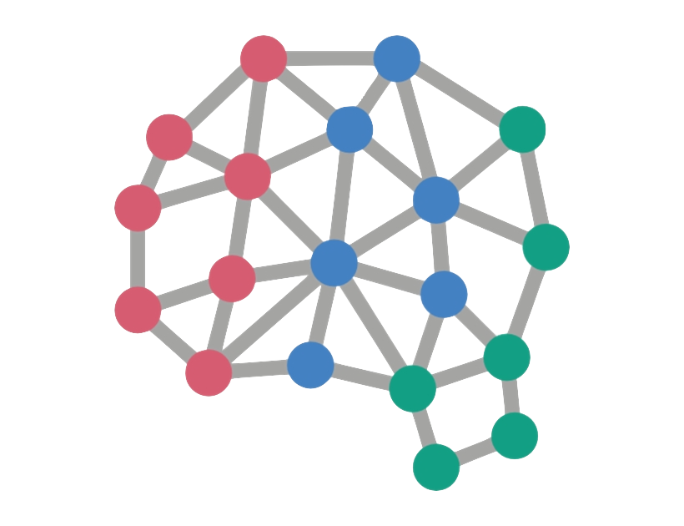
Next Steps
Stronger integration with Spotify API
Pull user’s “liked” tracks dynamically after authenticating
Upload new playlist to Spotify after finding similar tracks
Integrate with Apple Music/other platforms
Train neural networks to discover new song “features”
Audio File → Quantitative Score
Notes:
Ellek

Slide 7
Questions?

